Slide 1
Dual Link Manipulator
Dynamical Model

Slide 2
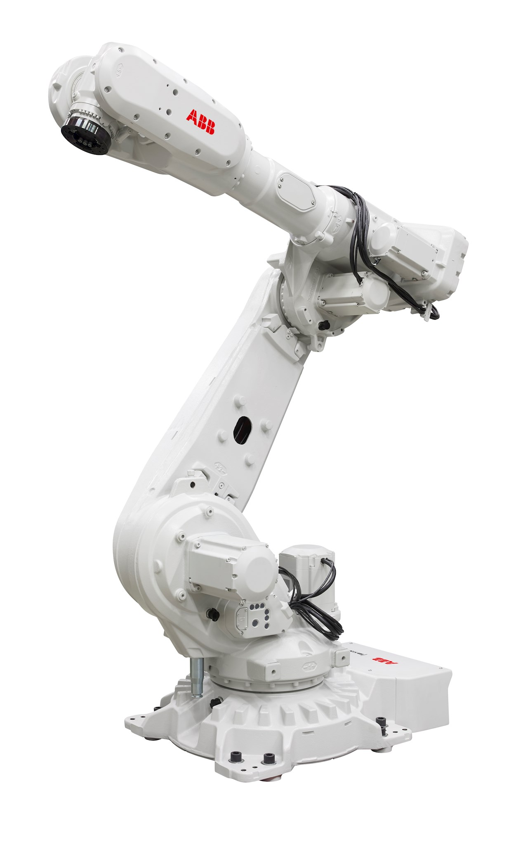
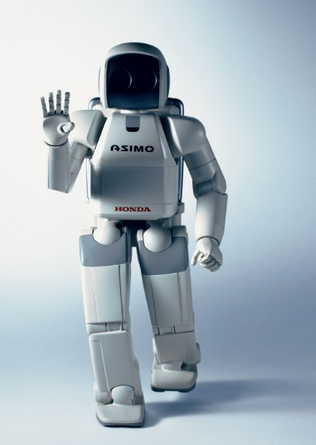





Dual Link Manipulator
Introduction
For this section, we’ll concentrate on a simple 2-link manipulator.
Some of the equations & analyses are surprisingly complex.
Is one of the most used configurations in the industry.
Can also be used to model legged robots.
Exhibits many of the basic locomotion problems associated with more complex skeleton models
IRB_5720
(ABB)
ASIMO
(Honda, Japan)

Slide 3
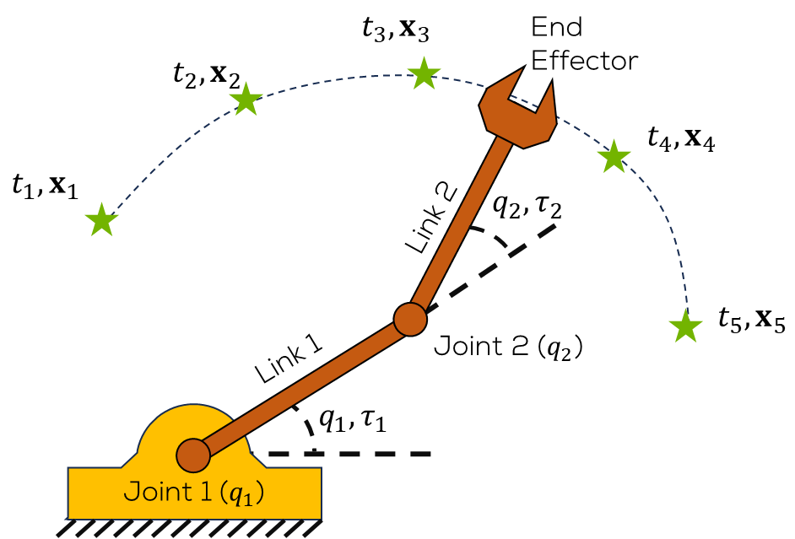
Dual Link Manipulator
Dual Link Manipulator (DLM)
Composed of 2 links and 2 joints
Joints are referenced to the horizontal.
We want to follow a trajectory with the end effector.
As with the SLM, a motor in each joint is usually used to move the links to a desired position.

Slide 4
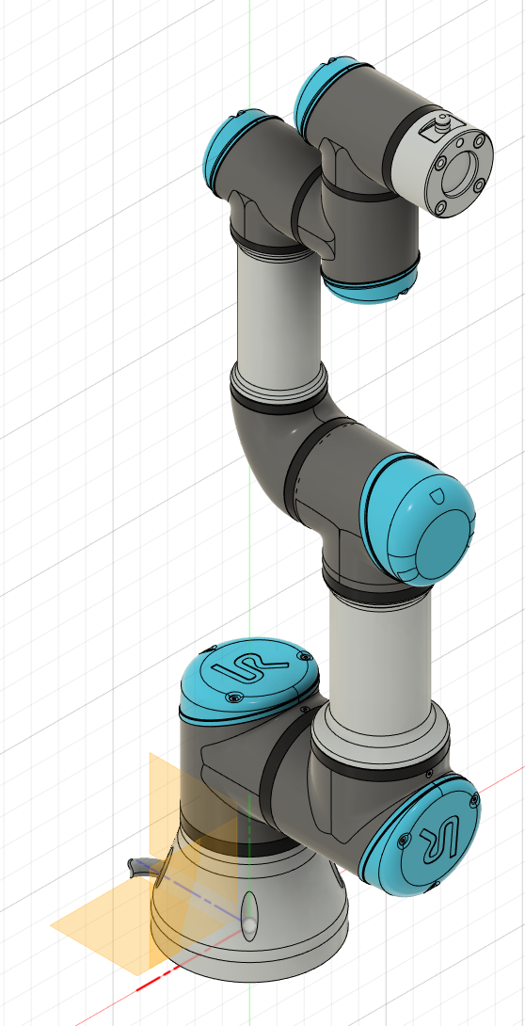
Dual Link Manipulator
Dual Link Manipulator
As for the previous SLM, the dynamics will be obtained using the Euler-Lagrange approach.
This analysis aims to enhance the comprehension of the intricate behaviour of the system and may be of interest to professionals working in this field.
Several levels of abstraction will be performed.

Slide 5

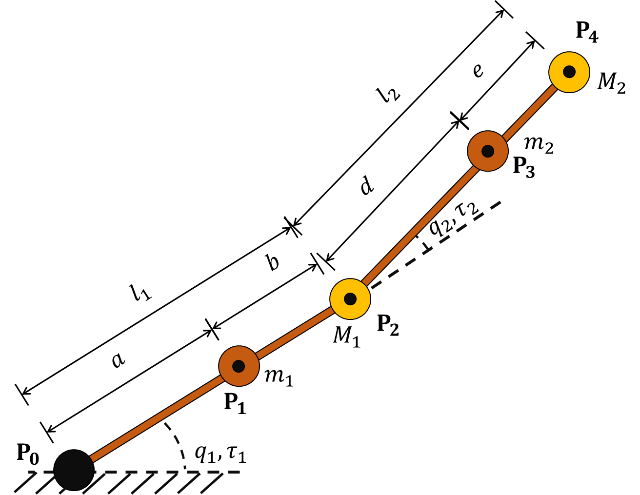

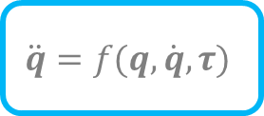

DLM Modelling
$$τ$$
$$\ddot{q}=f(q,\dot{q},τ)$$
$$q$$

Slide 6
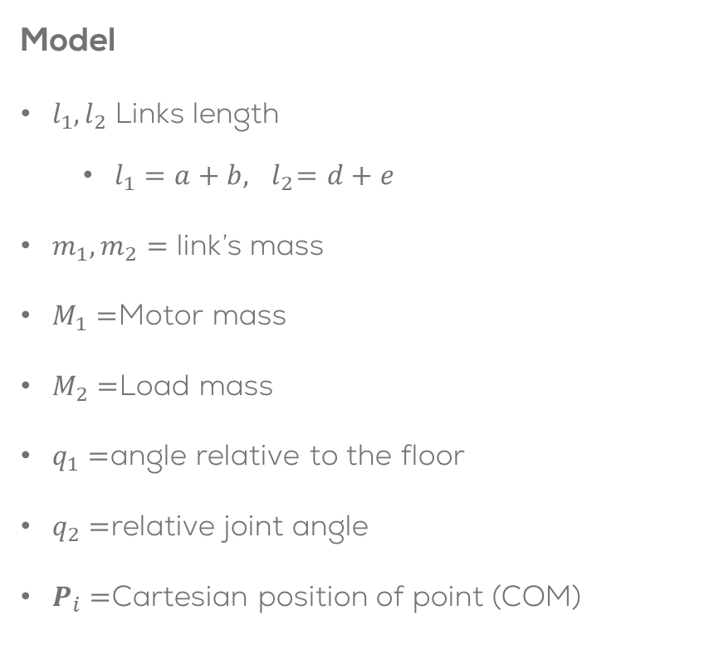
Dual Link Manipulator
Model
$l_{1}, l_{2}$ Links length
$l_{1}=a+b, { l}_{2}=d+e$
$m_{1}, m_{2}=$ link’s mass
$M_{1}=$Motor mass
$M_{2}=$Load mass
$q_{1}=$angle relative to the floor
$q_{2}=$relative joint angle
$P_{i}=$Cartesian position of point (COM)

Slide 7

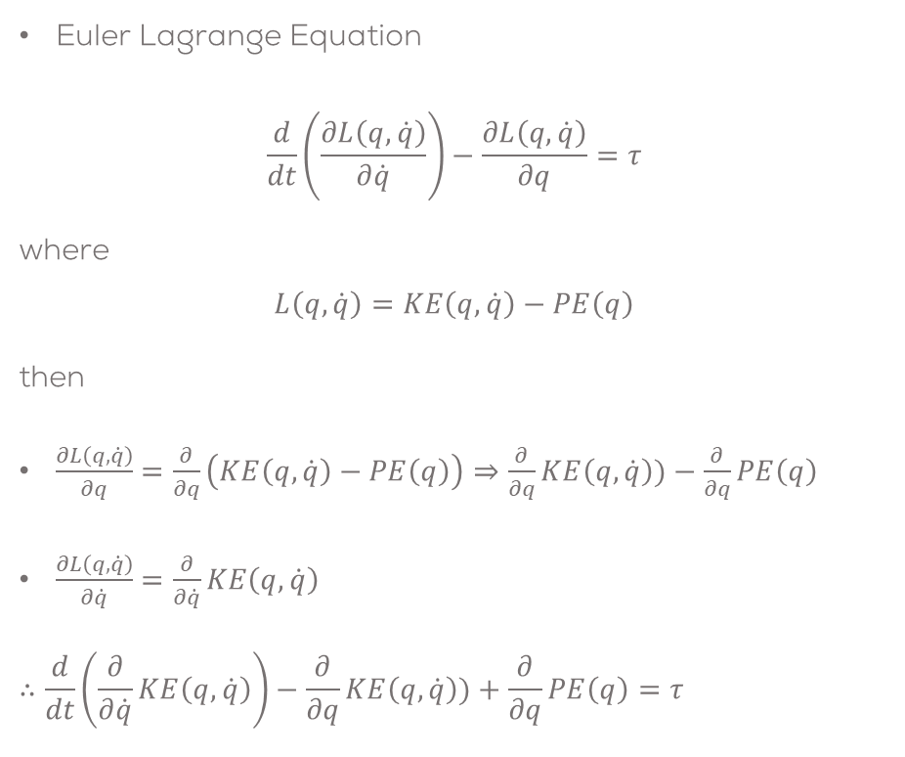
DLM Modelling
Euler Lagrange Equation
$$\frac{d}{dt}\left.\left(\frac{∂L\left(q,\dot{q}\right)}{∂\dot{q}}\right.\right)−\frac{∂L\left(q,\dot{q}\right)}{∂q}=τ$$
where
$$L\left(q,\dot{q}\right)=KE\left(q,\dot{q}\right)−PE\left(q\right)$$
then
$\frac{∂L\left(q,\dot{q}\right)}{∂q}=\frac{∂}{∂q}\left(KE\left(q,\dot{q}\right)−PE\left(q\right)\right)⇒\frac{∂}{∂q}KE\left(q,\dot{q}\right))−\frac{∂}{∂q}PE\left(q\right)$
$\frac{∂L\left(q,\dot{q}\right)}{∂\dot{q}}=\frac{∂}{∂\dot{q}}KE\left(q,\dot{q}\right)$
$$∴\frac{d}{dt}\left.\left(\frac{∂}{∂\dot{q}}KE\left(q,\dot{q}\right)\right.\right)−\frac{∂}{∂q}KE\left(q,\dot{q}\right))+\frac{∂}{∂q}PE\left(q\right)=τ$$

Slide 8
DLM Modelling
Euler Lagrange Equation
$$\frac{d}{dt}\left.\left(\frac{∂L\left(q,\dot{q}\right)}{∂\dot{q}}\right.\right)−\frac{∂L\left(q,\dot{q}\right)}{∂q}=τ$$
where
$$L\left(q,\dot{q}\right)=KE\left(q,\dot{q}\right)−PE\left(q\right)$$
then
$\frac{∂L\left(q,\dot{q}\right)}{∂q}=\frac{∂}{∂q}\left(KE\left(q,\dot{q}\right)−PE\left(q\right)\right)⇒\frac{∂}{∂q}KE\left(q,\dot{q}\right))−\frac{∂}{∂q}PE\left(q\right)$
$\frac{∂L\left(q,\dot{q}\right)}{∂\dot{q}}=\frac{∂}{∂\dot{q}}KE\left(q,\dot{q}\right)$
$$∴\frac{d}{dt}\left.\left(\frac{∂}{∂\dot{q}}KE\left(q,\dot{q}\right)\right.\right)−\frac{∂}{∂q}KE\left(q,\dot{q}\right))+\frac{∂}{∂q}PE\left(q\right)=τ$$

Slide 9
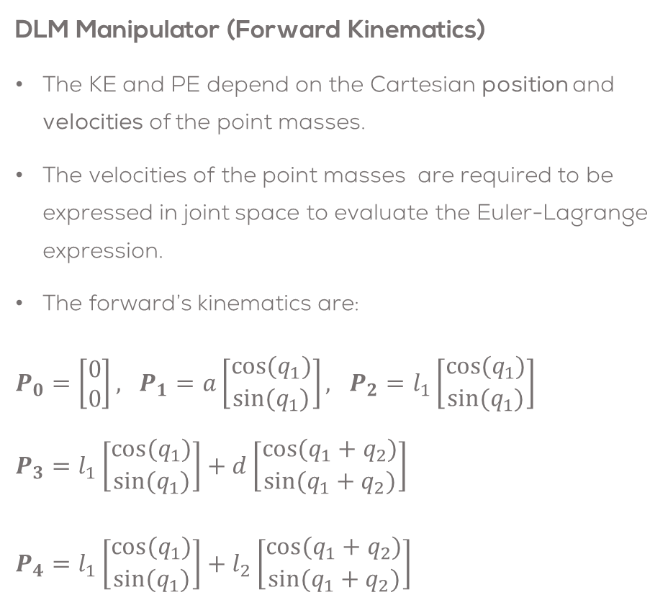
DLM Modelling
DLM Manipulator (Forward Kinematics)
The KE and PE depend on the Cartesian position and velocities of the point masses.
The velocities of the point masses are required to be expressed in joint space to evaluate the Euler-Lagrange expression.
The forward’s kinematics are:
$P_{0}=\left[\begin{matrix}0 \\ 0\end{matrix}\right], P_{1}=a\left[\begin{matrix}cos(q_{1}) \\ sin(q_{1})\end{matrix}\right], P_{2}=l_{1}\left[\begin{matrix}cos(q_{1}) \\ sin(q_{1})\end{matrix}\right]$ $P_{3}=l_{1}\left[\begin{matrix}cos(q_{1}) \\ sin(q_{1})\end{matrix}\right]+d\left[\begin{matrix}cos(q_{1}+q_{2}) \\ sin(q_{1}+q_{2})\end{matrix}\right]$
$P_{4}=l_{1}\left[\begin{matrix}cos(q_{1}) \\ sin(q_{1})\end{matrix}\right]+l_{2}\left[\begin{matrix}cos(q_{1}+q_{2}) \\ sin(q_{1}+q_{2})\end{matrix}\right]$

Slide 10
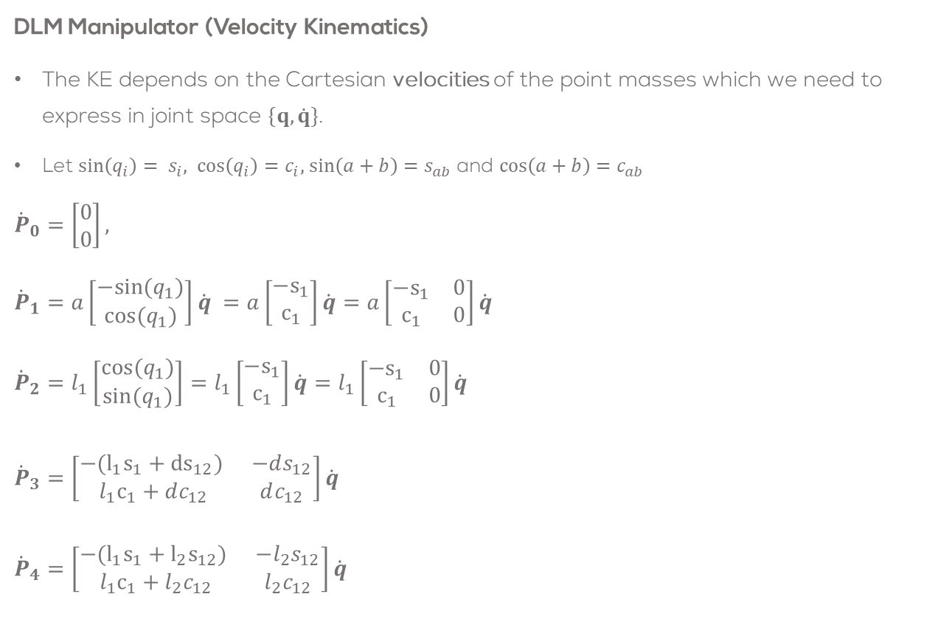
DLM Modelling
DLM Manipulator (Velocity Kinematics)
The KE depends on the Cartesian velocities of the point masses which we need to express in joint space $\{q,\dot{q}\}$.
Let $\sin\left(q_{i}\right)= s_{i}, \cos\left(q_{i}\right)=c_{i},$ $\sin\left(a+b\right)=s_{ab}$ and $\cos\left(a+b\right)=c_{ab}$
$${\dot{P}}_{0}=\left[\begin{matrix}0 \\ 0\end{matrix}\right],$$
$${\dot{P}}_{1}=a\left[\begin{matrix}−sin(q_{1}) \\ cos(q_{1})\end{matrix}\right]\dot{q} =a\left[\begin{matrix}−s_{1} \\ c_{1}\end{matrix}\right]\dot{q}=a\left[\begin{matrix}−s_{1} & 0 \\ c_{1} & 0\end{matrix}\right]\dot{q}$$
$${\dot{P}}_{2}=l_{1}\left[\begin{matrix}cos(q_{1}) \\ sin(q_{1})\end{matrix}\right]=l_{1}\left[\begin{matrix}−s_{1} \\ c_{1}\end{matrix}\right]\dot{q}=l_{1}\left[\begin{matrix}−s_{1} & 0 \\ c_{1} & 0\end{matrix}\right]\dot{q}$$ ${\dot{P}}_{3}=\left[\begin{matrix}−(l_{1}s_{1}+{ds}_{12}) & −ds_{12} \\ l_{1}c_{1}+dc_{12} & dc_{12}\end{matrix}\right]\dot{q}$
${\dot{P}}_{4}=\left[\begin{matrix}−(l_{1}s_{1}+{l_{2}s}_{12}) & −l_{2}s_{12} \\ l_{1}c_{1}+l_{2}c_{12} & l_{2}c_{12}\end{matrix}\right]\dot{q}$

